Slide 1
The sound of pixels Hang Zao, Chuang gan, Andrew rouditchenko, carl vondrick, josh mcdermott & Antonio torralba
Presenters: Ylenia Messina 1000008815, Eleonora Ocello 1000009379

Slide 2
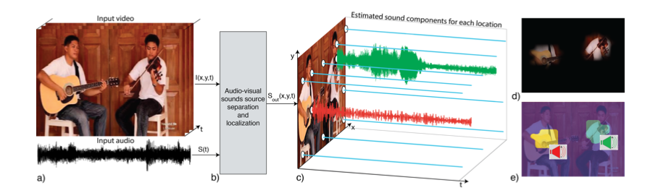
Motivation
The authors of this paper introduce PixelPlayer, a system that, by leveraging large amounts of unlabeled videos, learns to locate image regions which produce sounds and separate the input sounds into a set of components that represents the sound of each pixel.
http://sound-of-pixels.csail.mit.edu
Auditory scene analysis is widely studied in the fields of environmental sound recognition and source separation. Training systems to recognize objects from vision or sound typically requires large amounts of supervision.

Slide 3
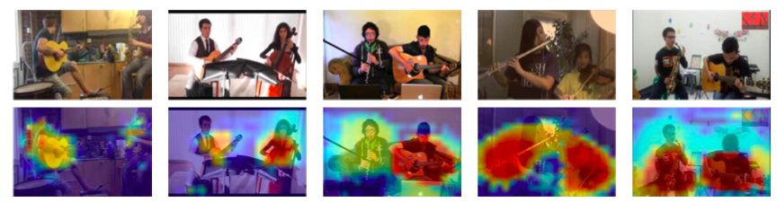
Contribution
The paper fundamentally solves two problems:
Sound localization: “which pixels are making sounds?”

Slide 4
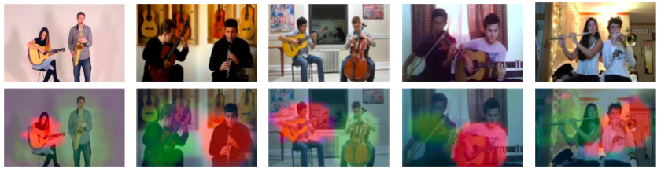
Contribution
Clustering of sounds: “what sounds do this pixels make?”
For each pixel they took the vectorized log spectrogram magnitudes and projected them onto 3D RGB space using PCA for visualization purposes.

Slide 5
State of the art
Sound source separation: “cocktail party problem”, methods enable applications ranging from music/vocal separation, to speech separation and enhancement. [1] [2] [3]
Learning visual-audio correspondence: people studied how to localize sounds in vision according to motion [4] or semantic cues. [5] [6]
Self-supervised learning: The work builds off efforts to learn perceptual models that are “self-supervised” by leveraging natural contextual signals in images [7] [8], videos [9] [10] and even radio signals [11]
[1]. Gabbay, A., Ephrat, A., Halperin, T., Peleg, S.: Seeing through noise: Speaker separation and enhancement using visually-derived speech. arXiv preprint arXiv:1708.06767 (2017)
[2]. Hershey,J.R.,Chen,Z.,LeRoux,J.,Watanabe,S.:Deepclustering:Discriminative embeddings for segmentation and separation. In: Acoustics, Speech and Signal Processing (ICASSP), 2016 IEEE International Conference on. pp. 31–35. IEEE (2016)
[3]. Nagrani, A., Albanie, S., Zisserman, A.: Seeing voices and hearing faces: Cross- modal biometric matching. arXiv preprint arXiv:1804.00326 (2018)
[4]. Belouchrani, A., Abed-Meraim, K., Cardoso, J.F., Moulines, E.: A blind source separation technique using second-order statistics. IEEE Transactions on signal processing 45(2), 434–444 (1997)
[5]. Arandjelovi ́c, R., Zisserman, A.: Objects that sound. arXiv preprint arXiv:1712.06651 (2017)
[6]. Senocak, A., Oh, T.H., Kim, J., Yang, M.H., Kweon, I.S.: Learning to localize sound source in visual scenes. arXiv preprint arXiv:1803.03849 (2018)
[7]. Doersch, C., Gupta, A., Efros, A.A.: Unsupervised visual representation learning by context prediction. In: Proceedings of the IEEE International Conference on Computer Vision. pp. 1422–1430 (2015)
[8]. Larsson, G., Maire, M., Shakhnarovich, G.: Colorization as a proxy task for visual understanding. In: CVPR. vol. 2, p. 8 (2017)
[9]. Wang, X., Gupta, A.: Unsupervised learning of visual representations using videos. In: ICCV. pp. 2794–2802 (2015)
[10]. Pathak, D., Girshick, R., Doll ́ar, P., Darrell, T., Hariharan, B.: Learning features by watching objects move. In: Proc. CVPR. vol. 2 (2017)
[11]. Zhao, M., Li, T., Abu Alsheikh, M., Tian, Y., Zhao, H., Torralba, A., Katabi, D.: Through-wall human pose estimation using radio signals. In: Proceedings of the IEEE Conference on Computer Vision and Pattern Recognition. pp. 7356–7365 (2018)

Slide 6
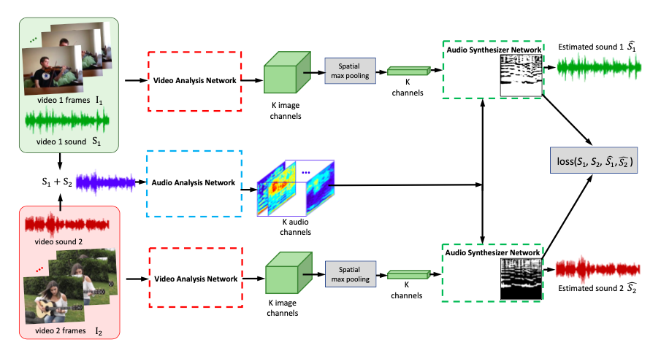
Proposed approach – The overall idea
Mix and Separate framework for Self-supervised Training: the learning objective of the model is to separate a sound source of interest conditioned on the visual input associated with it.

Slide 7
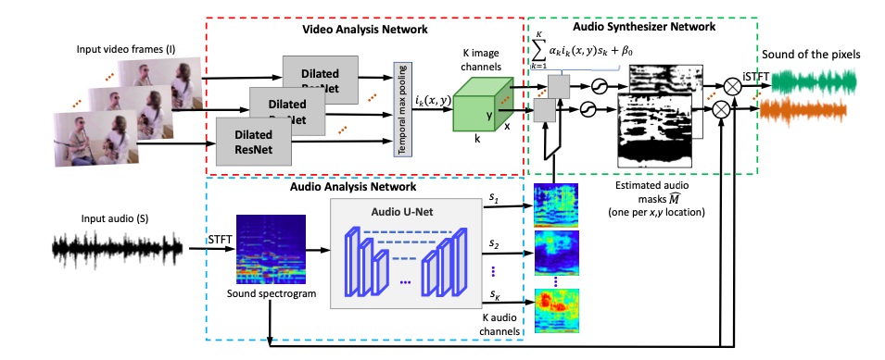
Proposed approach – Model’s architecture

Slide 8
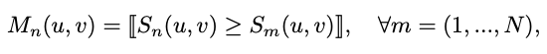
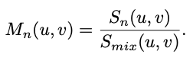
Proposed approach – Loss
The learning target in the system are the spectrogram masks:
Binary:
Per-pixel sigmoid cross entropy loss is used for learning.
Ratios:
.
Per-pixel L1 loss is used for training.

Slide 9
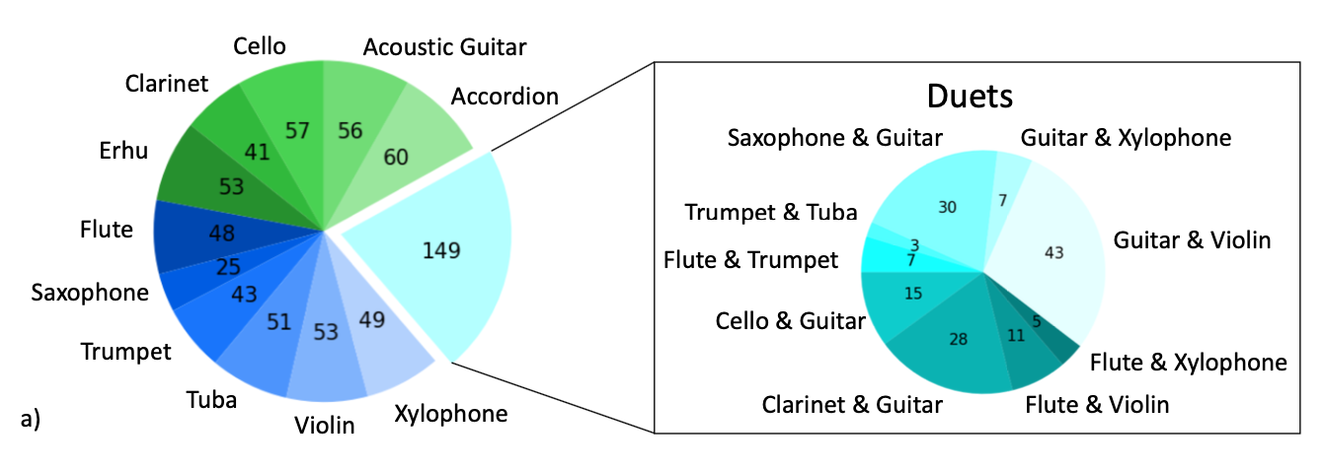
Experimental Results – Datasets
The dataset used is the MUSIC (Multimodal Sources of Instrument Combinations) dataset, which is composed of 685 untrimmed videos of musical solos and duets which were retrieved from YouTube by keyword query.
The dataset spans 11 instrument categories [Fig. a)] and it is split into:
500 videos → Training
130 videos → Validation
84 videos → Test

Slide 10
Experimental Results – Metrics
For the objective evaluation:
NSDR → Normalized Signal-to-Distortion Ratio.
SIR → Signal-to-Interference Ratio.
SAR → Signal-to-Artifact Ratio.
For the subjective evaluation:
Answers of 3 independent AMT (Amazon Mechanical Turk) workers.

Slide 11
Experimental Results – Training Procedure
Data pre-processing
Sub-sample audio signals to 11kHz;
Compute on the audio samples a STFT (Short-term Fourier transform) with a window size of 1022 and a hop length of 256, resulting in a 512x256 T-F (Time-Frequency) representation of the sound;
Re-sample the signal on a log-frequency scale to obtain a 256x256 T-F representation.
Convert the mask back to linear frequency scale with size 512x256, which can be applied on the input spectrogram;
Perform an inverse STFT to obtain the recovered signal.
The log magnitude values of T-F units are used as the input to the audio analysis network. After obtaining the output mask from the model:

Slide 12
Experimental Results – Training Procedure
Hyperparameters
SGD optimizer with momentum 0.9
Learning rate set as:
0.001 → in both the audio analysis network & the audio synthesizer network
0.0001 → in the video analysis network

Slide 13
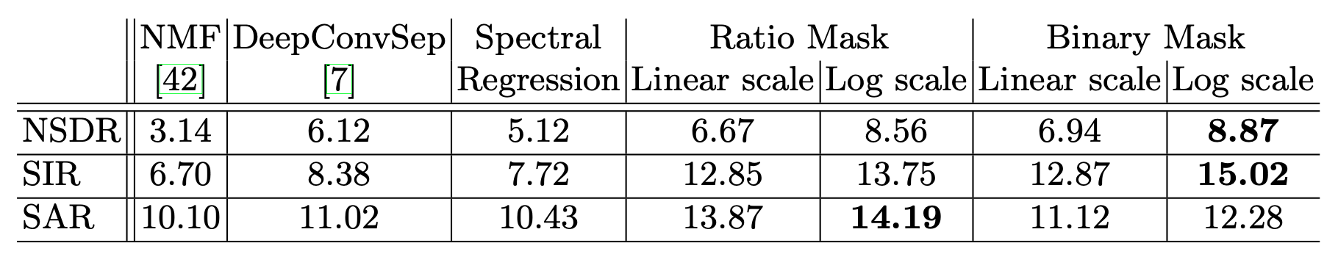
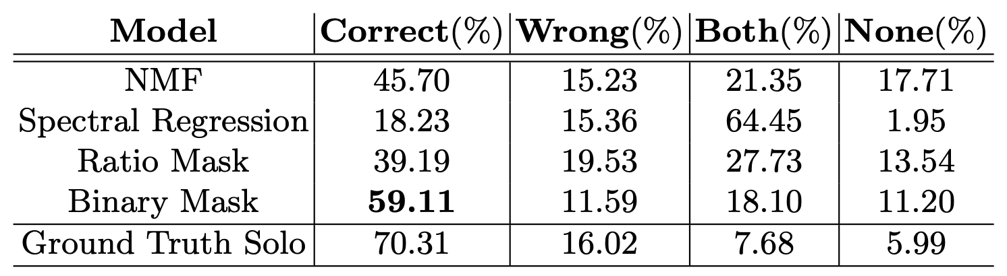
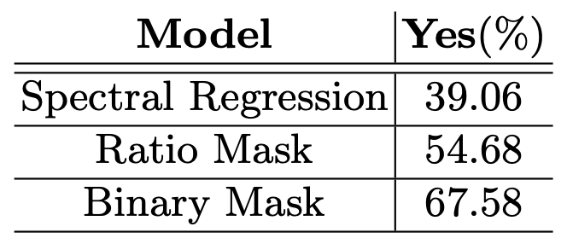
Experimental Results – Quantitative Results
The objective evaluation:
The subjective evaluation of sound separation performance (table on the left) and visual-sound correspondence (table on the right):

Slide 14
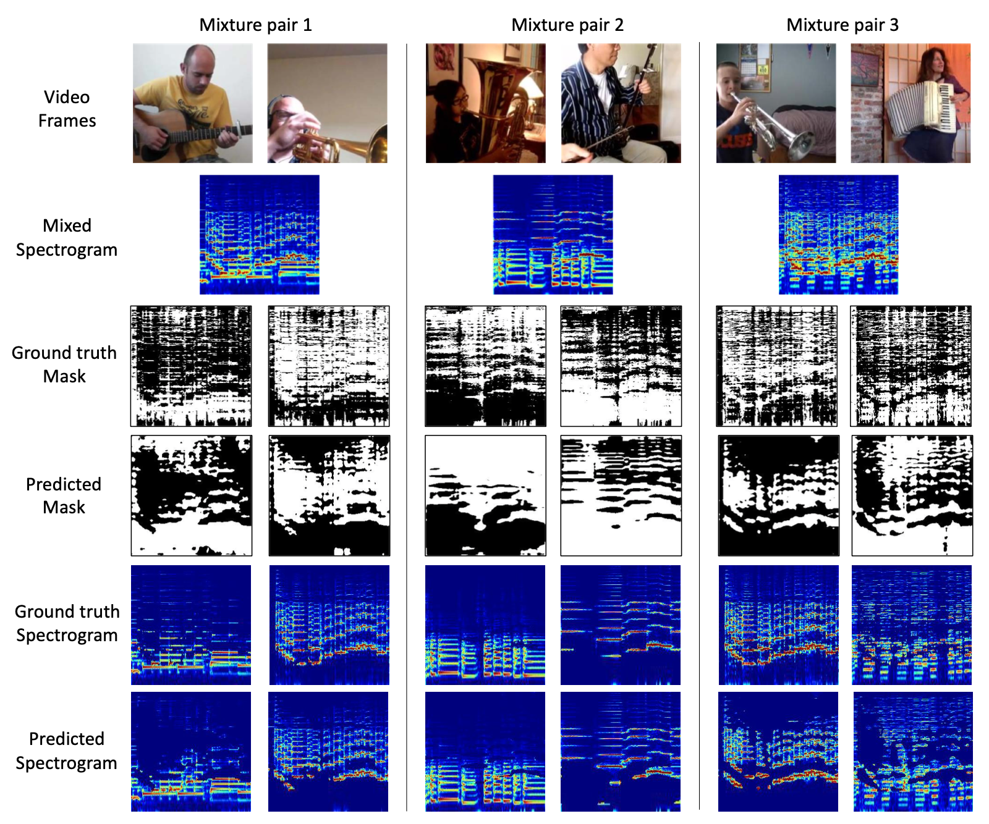
Experimental Results – Qualitative Results

Slide 15
Conclusion
Quantitative results, qualitative results, and subjective user studies demonstrate the effectiveness of the cross-modal learning system PixelPlayer.
Authors also expect that this work can open up new research avenues for understanding the problem of sound source separation using both visual and auditory signals.

Slide 16
Take-home message
In general, PixelPlayer will allow more isolated processing of the sound coming from each object and will aid auditory recognition.
Possible application scenarios?
Facilitate sound editing in videos, enabling volume adjustments for specific objects or removal of the audio from particular sources.
Isolate individual speakers from multi-talker simultaneous speech in videos.

